Slide 1

Unsupervised Learning

Slide 2

Unsupervised Learning
Data
Rules
Computer

Slide 3


Supervised Learning
$$x_{2}$$
$$x_{1}$$

Slide 4
Supervised Learning
$$x_{2}$$
$$x_{1}$$

Slide 5
Supervised Learning
$$x_{2}$$
$$x_{1}$$

Slide 6
Supervised Learning
test example
$$x_{2}$$
$$x_{1}$$

Slide 7
Supervised Learning
$$x_{2}$$
$$x_{1}$$

Slide 8
Supervised Learning
$$x_{2}$$
$$x_{1}$$

Slide 9
Unsupervised Learning
$$x_{2}$$
$$x_{1}$$

Slide 10
Unsupervised Learning
$$x_{2}$$
$$x_{1}$$

Slide 11
Unsupervised Learning
$$x_{2}$$
$$x_{1}$$

Slide 12

Unsupervised Learning
$$x_{2}$$
test example
$$x_{1}$$

Slide 13
Unsupervised Learning
$$x_{2}$$
$$x_{1}$$

Slide 14
K-Means Algorithm

Slide 15
K-Means Algorithm
K-Means is an unsupervised learning technique for grouping similar objects together.
K-Means can be used for a variety of tasks, such as market segmentation, DNA analysis, image compression, …etc.

Slide 16
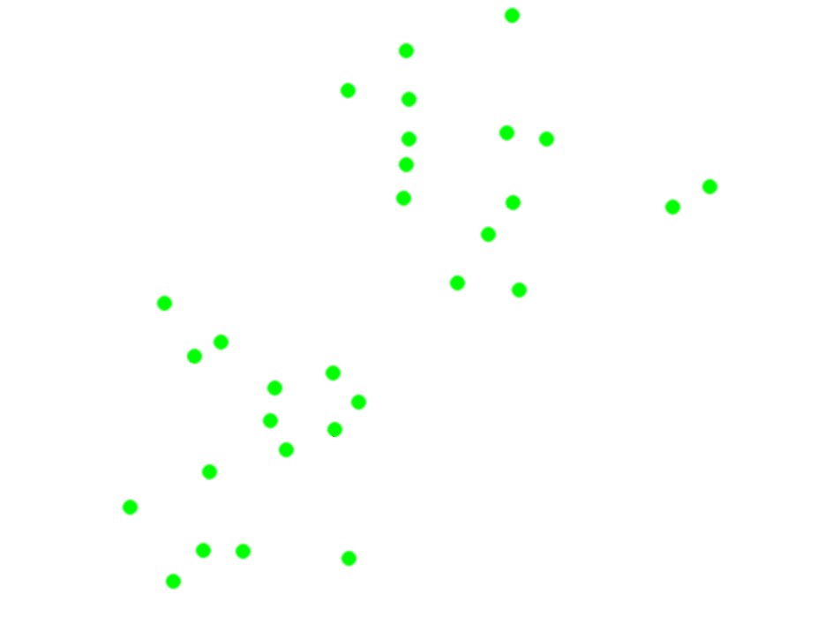

K-Means Algorithm
Let $K = 2$

Slide 17
K-Means Algorithm
Cluster Centroid

Slide 18
K-Means Algorithm

Slide 19
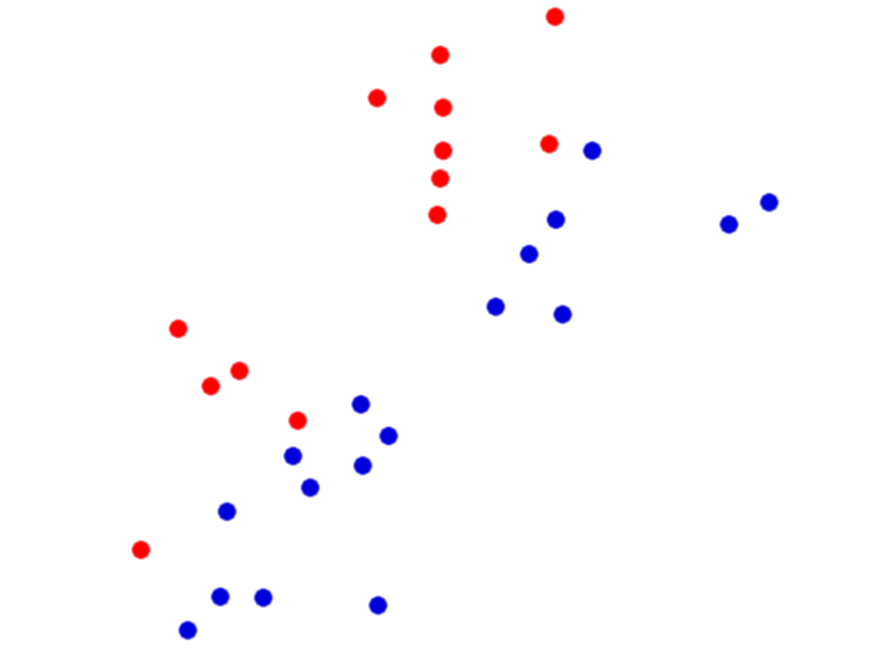
K-Means Algorithm

Slide 20
K-Means Algorithm

Slide 21
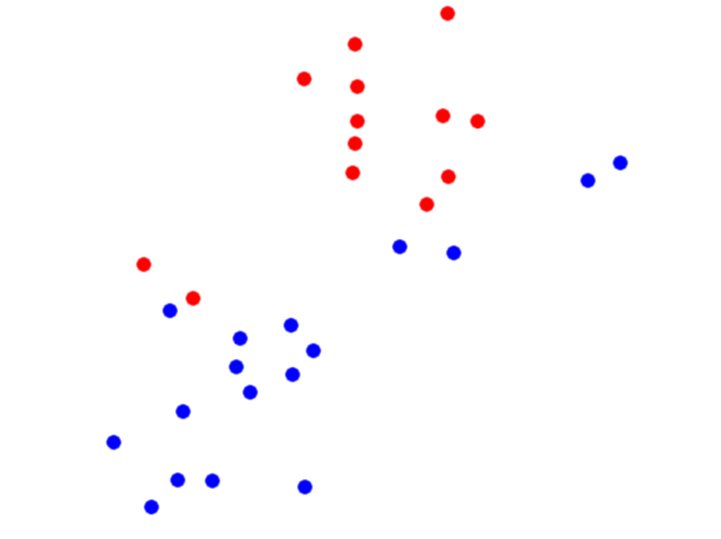
K-Means Algorithm

Slide 22
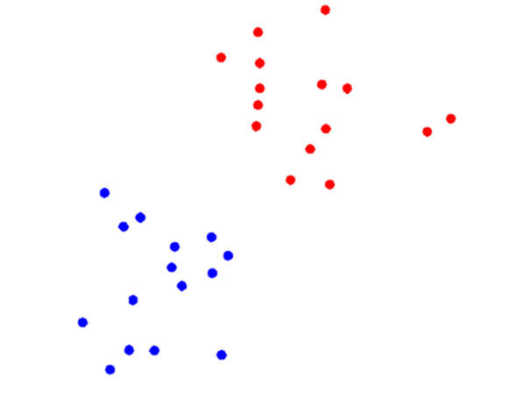
K-Means Algorithm

Slide 23
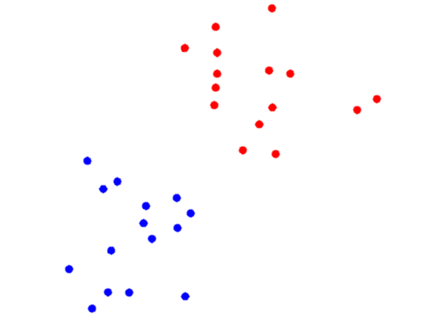
K-Means Algorithm

Slide 24
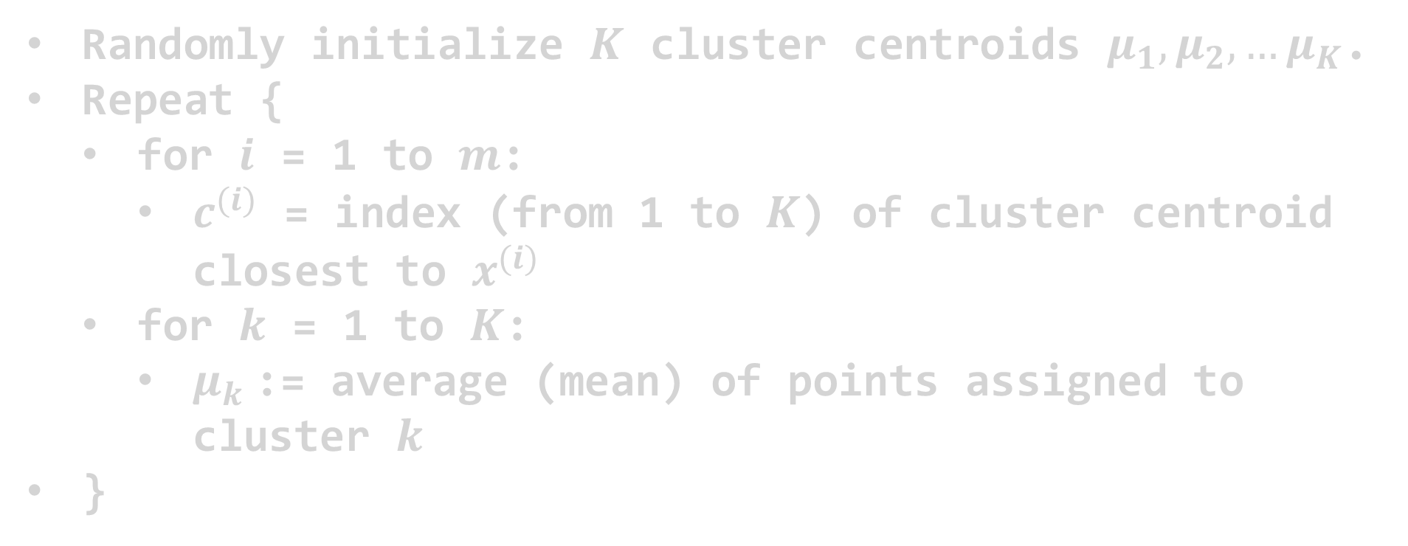
K-Means Algorithm
Randomly initialize $K$ cluster centroids $μ_{1},μ_{2},…μ_{K}$.
Repeat {
for $i$ = 1 to $m$:
$c^{(i)}$ = index (from 1 to $K$) of cluster centroid closest to $x^{(i)}$
for $k$ = 1 to $K$:
$μ_{k}$:= average (mean) of points assigned to cluster $k$
}

Slide 25
Distortion Function

Slide 26
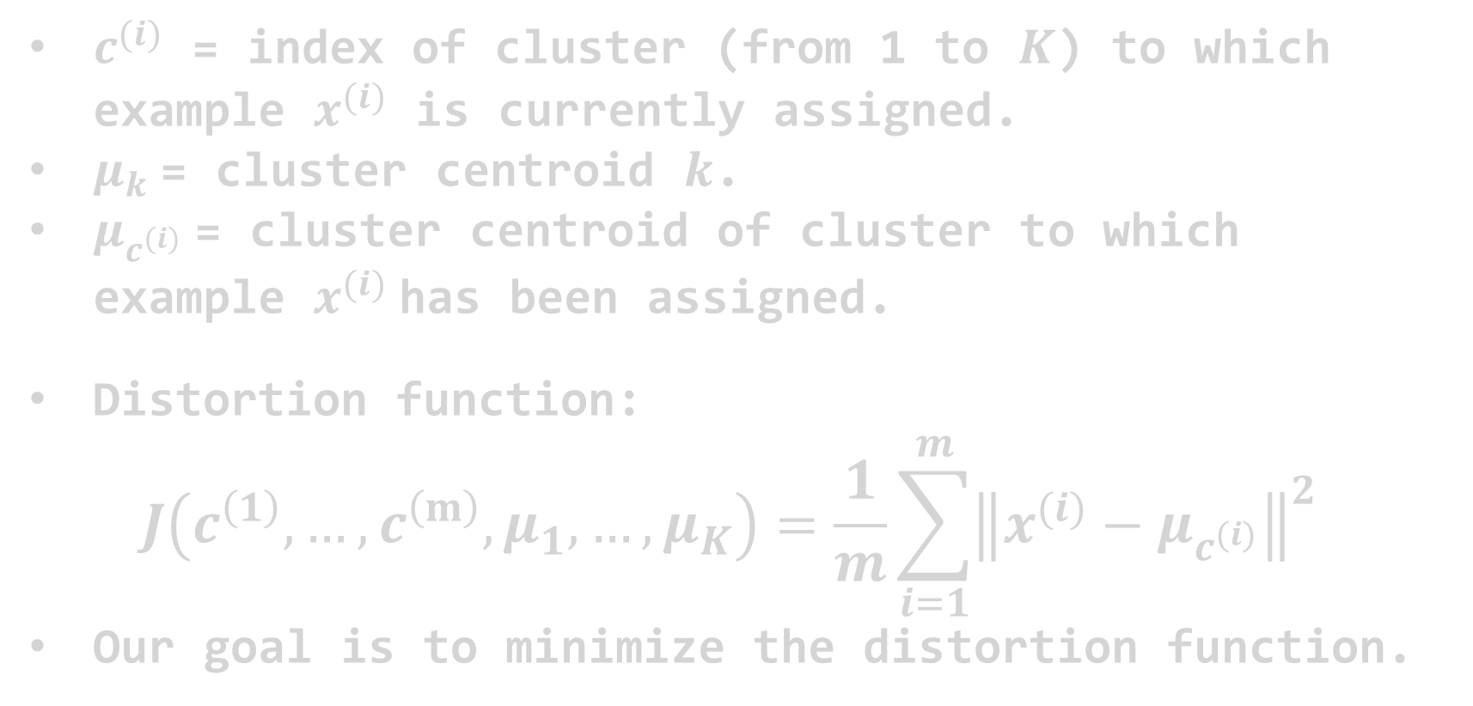
Distortion Function
$c^{(i)}$ = index of cluster (from 1 to $K$) to which example $x^{(i)}$ is currently assigned.
$μ_{k}$= cluster centroid $k$.
$μ_{c^{(i)}}$= cluster centroid of cluster to which example $x^{(i)}$has been assigned.
Distortion function:
$$J\left(c^{\left(1\right)}, …,c^{\left(m\right)},μ_{1},…,μ_{K}\right)=\frac{1}{m}\sum_{i=1}^{m}{{\left\|x^{(i)}−μ_{c^{(i)}}\right\|}^{2}}$$
Our goal is to minimize the distortion function.

Slide 27
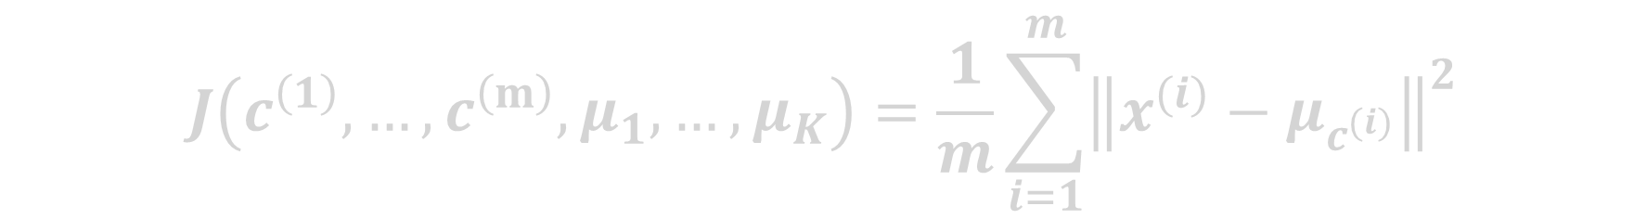
Distortion Function
$$J\left(c^{\left(1\right)}, …,c^{\left(m\right)},μ_{1},…,μ_{K}\right)=\frac{1}{m}\sum_{i=1}^{m}{{\left\|x^{(i)}−μ_{c^{(i)}}\right\|}^{2}}$$

Slide 28
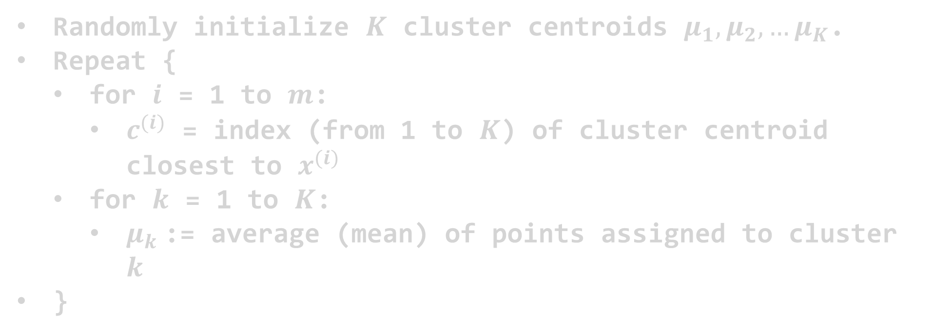
Distortion Function
$$J\left(c^{\left(1\right)}, …,c^{\left(m\right)},μ_{1},…,μ_{K}\right)=\frac{1}{m}\sum_{i=1}^{m}{{\left\|x^{(i)}−μ_{c^{(i)}}\right\|}^{2}}$$
Randomly initialize $K$ cluster centroids $μ_{1},μ_{2},…μ_{K}$.
Repeat {
for $i$ = 1 to $m$:
$c^{(i)}$ = index (from 1 to $K$) of cluster centroid closest to $x^{(i)}$
for $k$ = 1 to $K$:
$μ_{k}$:= average (mean) of points assigned to cluster $k$
}

Slide 29

Distortion Function
$$J\left(c^{\left(1\right)}, …,c^{\left(m\right)},μ_{1},…,μ_{K}\right)=\frac{1}{m}\sum_{i=1}^{m}{{\left\|x^{(i)}−μ_{c^{(i)}}\right\|}^{2}}$$
Repeat {
for $i$ = 1 to $m$:
$c^{(i)}$ = index (from 1 to $K$) of cluster centroid closest to $x^{(i)}$
for $k$ = 1 to $K$:
$μ_{k}$:= average (mean) of points assigned to cluster $k$
}

Slide 30
Distortion Function
$$J\left(c^{\left(1\right)}, …,c^{\left(m\right)},μ_{1},…,μ_{K}\right)=\frac{1}{m}\sum_{i=1}^{m}{{\left\|x^{(i)}−μ_{c^{(i)}}\right\|}^{2}}$$
Repeat {
for $i$ = 1 to $m$:
$c^{(i)}$ = index (from 1 to $K$) of cluster centroid closest to $x^{(i)}$
for $k$ = 1 to $K$:
$μ_{k}$:= average (mean) of points assigned to cluster $k$
}

Slide 31
Distortion Function
$$J\left(c^{\left(1\right)}, …,c^{\left(m\right)},μ_{1},…,μ_{K}\right)=\frac{1}{m}\sum_{i=1}^{m}{{\left\|x^{(i)}−μ_{c^{(i)}}\right\|}^{2}}$$
Repeat {
for $i$ = 1 to $m$:
$c^{(i)}$ = index (from 1 to $K$) of cluster centroid closest to $x^{(i)}$
for $k$ = 1 to $K$:
$μ_{k}$:= average (mean) of points assigned to cluster $k$
}

Slide 32
Distortion Function
$$J\left(c^{\left(1\right)}, …,c^{\left(m\right)},μ_{1},…,μ_{K}\right)=\frac{1}{m}\sum_{i=1}^{m}{{\left\|x^{(i)}−μ_{c^{(i)}}\right\|}^{2}}$$
Repeat {
for $i$ = 1 to $m$:
$c^{(i)}$ = index (from 1 to $K$) of cluster centroid closest to $x^{(i)}$
for $k$ = 1 to $K$:
$μ_{k}$:= average (mean) of points assigned to cluster $k$
}

Slide 33
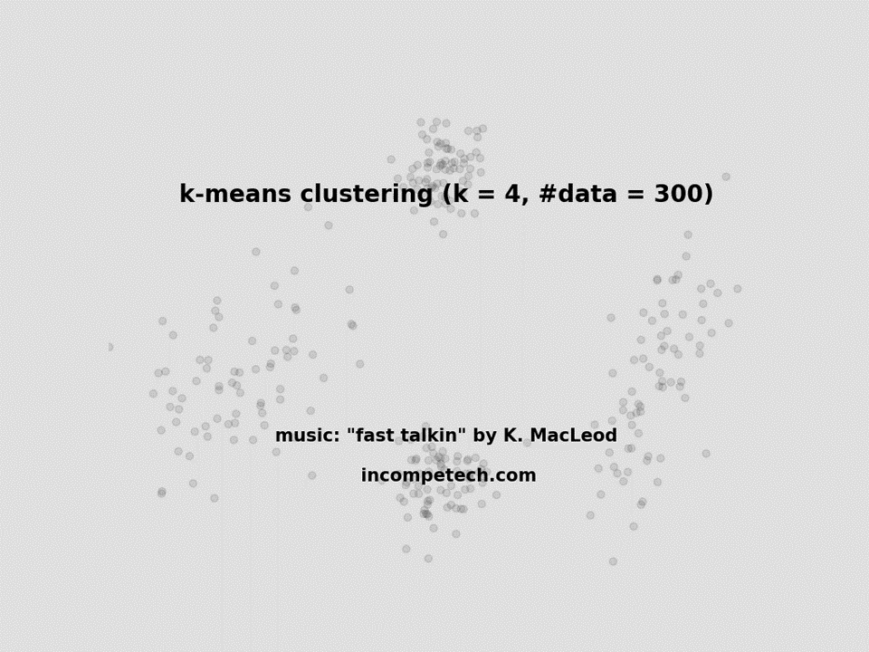

Slide 34
Random Initialization

Slide 35
Random Initialization
$$x_{2}$$
$$x_{1}$$

Slide 36
Random Initialization
$$x_{2}$$
$$x_{1}$$

Slide 37
Random Initialization
$$x_{2}$$
$$x_{1}$$

Slide 38
Random Initialization
$$x_{2}$$
$$x_{1}$$

Slide 39
Random Initialization
$$x_{2}$$
$$x_{1}$$

Slide 40
Random Initialization
$$x_{2}$$
Eliminate this cluster
$$x_{1}$$

Slide 41
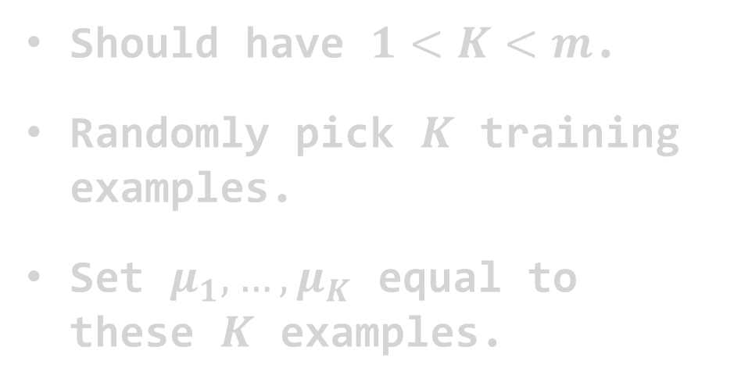


Random Initialization
Should have $1<K<m$.
Randomly pick $K$ training examples.
Set $μ_{1},…,μ_{K}$ equal to these $K$ examples.
$$x_{2}$$
$$x_{1}$$

Slide 42
Random Initialization
Should have $1<K<m$.
Randomly pick $K$ training examples.
Set $μ_{1},…,μ_{K}$ equal to these $K$ examples.
$$x_{2}$$
$$x_{1}$$

Slide 43
Random Initialization
Should have $1<K<m$.
Randomly pick $K$ training examples.
Set $μ_{1},…,μ_{K}$ equal to these $K$ examples.
$$x_{2}$$
$$x_{1}$$

Slide 44
Random Initialization
Should have $1<K<m$.
Randomly pick $K$ training examples.
Set $μ_{1},…,μ_{K}$ equal to these $K$ examples.
$$x_{2}$$
$$x_{1}$$

Slide 45
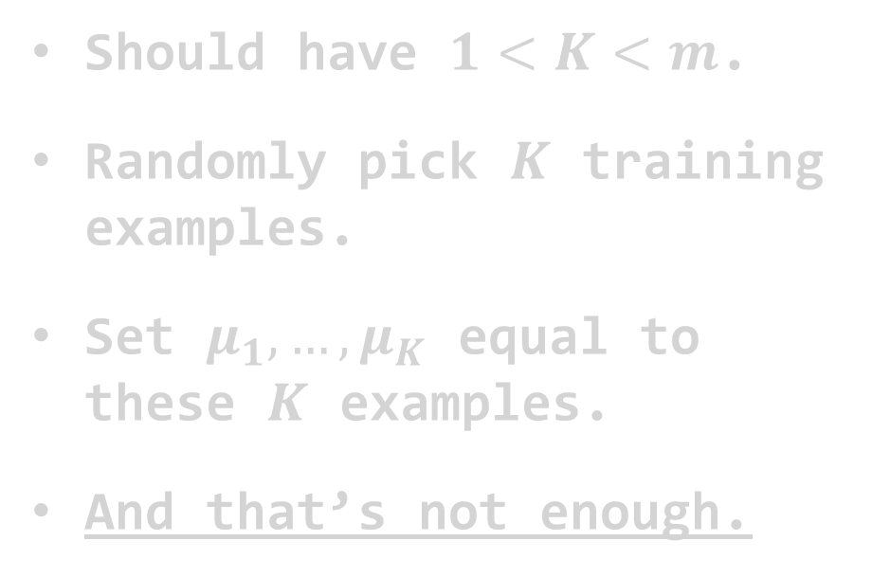
Random Initialization
Should have $1<K<m$.
Randomly pick $K$ training examples.
Set $μ_{1},…,μ_{K}$ equal to these $K$ examples.
And that’s not enough.
$$x_{2}$$
$$x_{1}$$
K-means clustering. Data Points (shabal.in)

Slide 46
Random Initialization
Should have $1<K<m$.
Randomly pick $K$ training examples.
Set $μ_{1},…,μ_{K}$ equal to these $K$ examples.
And that’s not enough.
$$x_{2}$$
$$x_{1}$$
K-means clustering. Data Points (shabal.in)

Slide 47
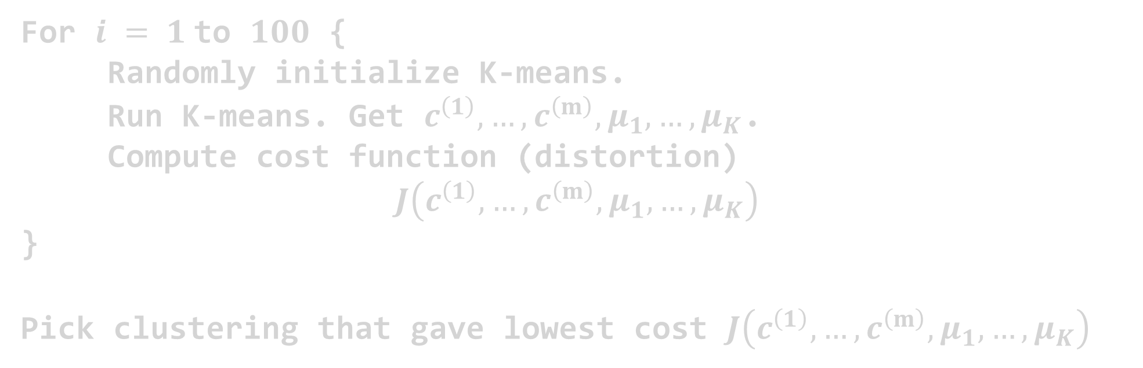
Random Initialization
For $i = 1$to $100$ {
Randomly initialize K-means.
Run K-means. Get $c^{\left(1\right)}, …,c^{\left(m\right)},μ_{1},…,μ_{K}$.
Compute cost function (distortion)
$$J\left(c^{\left(1\right)}, …,c^{\left(m\right)},μ_{1},…,μ_{K}\right)$$
}
Pick clustering that gave lowest cost $J\left(c^{\left(1\right)}, …,c^{\left(m\right)},μ_{1},…,μ_{K}\right)$

Slide 48
What about K !?

Slide 49




What about $K$ !?
How to pick value for $K$?
No right answers.
$$x_{2}$$
$$x_{1}$$

Slide 50
What about $K$ !?
How to pick value for $K$?
No right answers.
$$x_{2}$$
$$x_{1}$$

Slide 51
What about $K$ !?
How to pick value for $K$?
No right answers.
$$x_{2}$$
$$x_{1}$$

Slide 52


What about $K$ !?
Elbow Method:
$$J$$
$$K$$

Slide 53
What about $K$ !?
Elbow Method:
$$J$$
$$K$$

Slide 54
What about $K$ !?
Elbow Method:
$$J$$
$$K$$

Slide 55
Image Compression

Slide 56
Image Compression

Slide 57
Image Compression
Images are represented in computers using pixels, which are the smallest unit of information in an image.
Each pixel contains information about its color and intensity. In a grayscale image, each pixel is represented by a single value indicating the intensity of the gray color. In a color image, each pixel is represented by three values, indicating the intensity of red, green, and blue (RGB) colors.
These values are usually represented as 8-bit unsigned integers ranging from 0 to 255, where 0 represents the absence of the color and 255 represents its full intensity. The combination of all pixels forms the complete image.

Slide 58
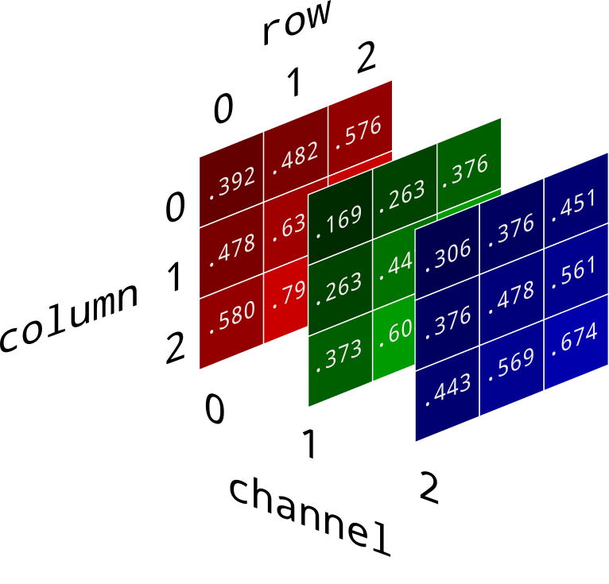
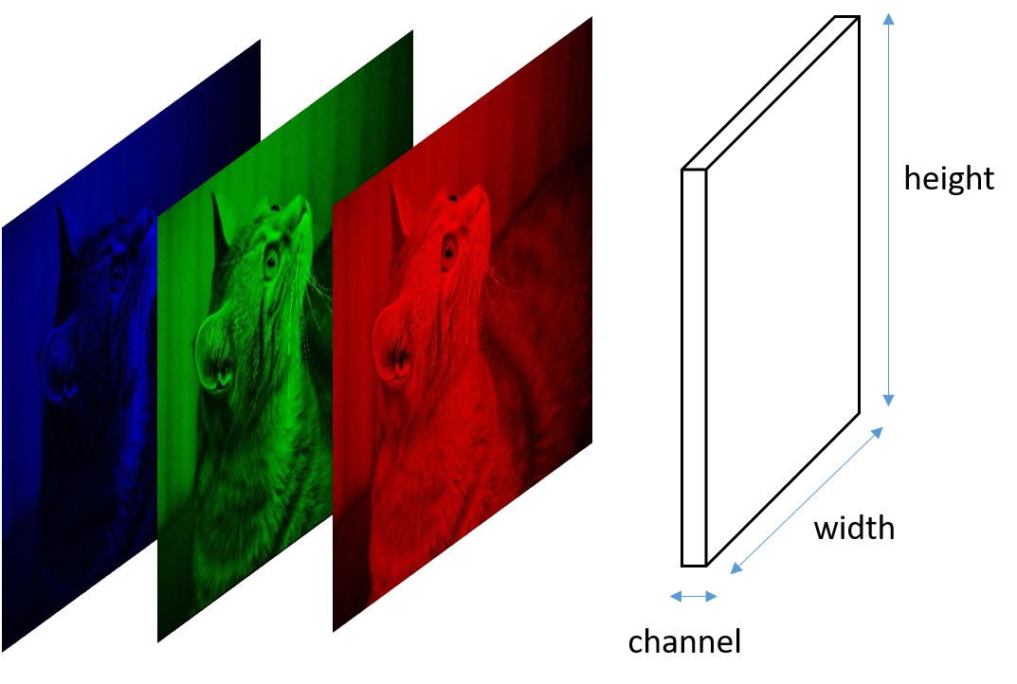
Image Compression

Slide 59
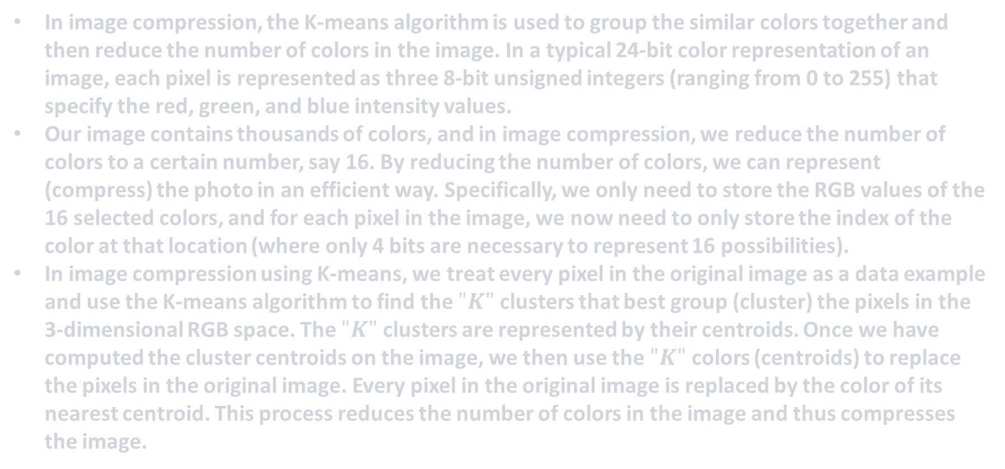
Image Compression
In image compression, the K-means algorithm is used to group the similar colors together and then reduce the number of colors in the image. In a typical 24-bit color representation of an image, each pixel is represented as three 8-bit unsigned integers (ranging from 0 to 255) that specify the red, green, and blue intensity values.
Our image contains thousands of colors, and in image compression, we reduce the number of colors to a certain number, say 16. By reducing the number of colors, we can represent (compress) the photo in an efficient way. Specifically, we only need to store the RGB values of the 16 selected colors, and for each pixel in the image, we now need to only store the index of the color at that location (where only 4 bits are necessary to represent 16 possibilities).
In image compression using K-means, we treat every pixel in the original image as a data example and use the K-means algorithm to find the $"K"$ clusters that best group (cluster) the pixels in the 3-dimensional RGB space. The $"K"$ clusters are represented by their centroids. Once we have computed the cluster centroids on the image, we then use the $"K"$ colors (centroids) to replace the pixels in the original image. Every pixel in the original image is replaced by the color of its nearest centroid. This process reduces the number of colors in the image and thus compresses the image.

Slide 60
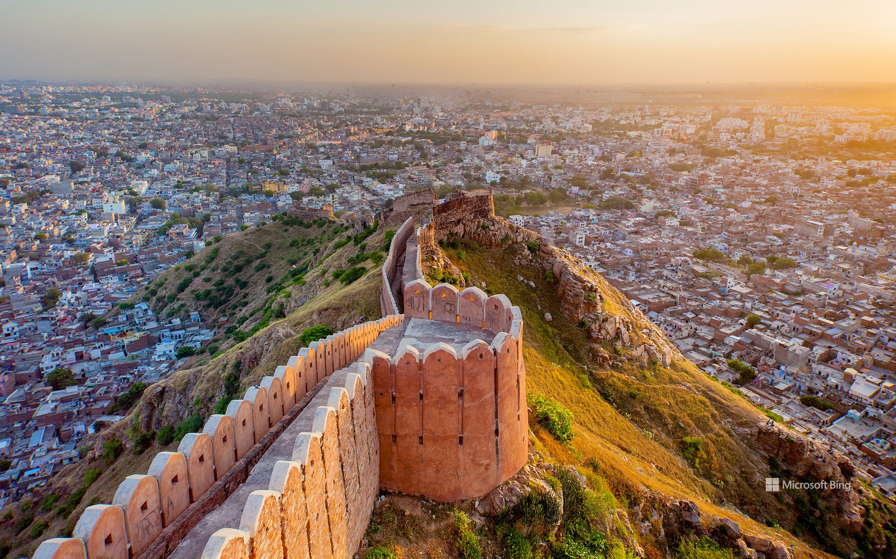
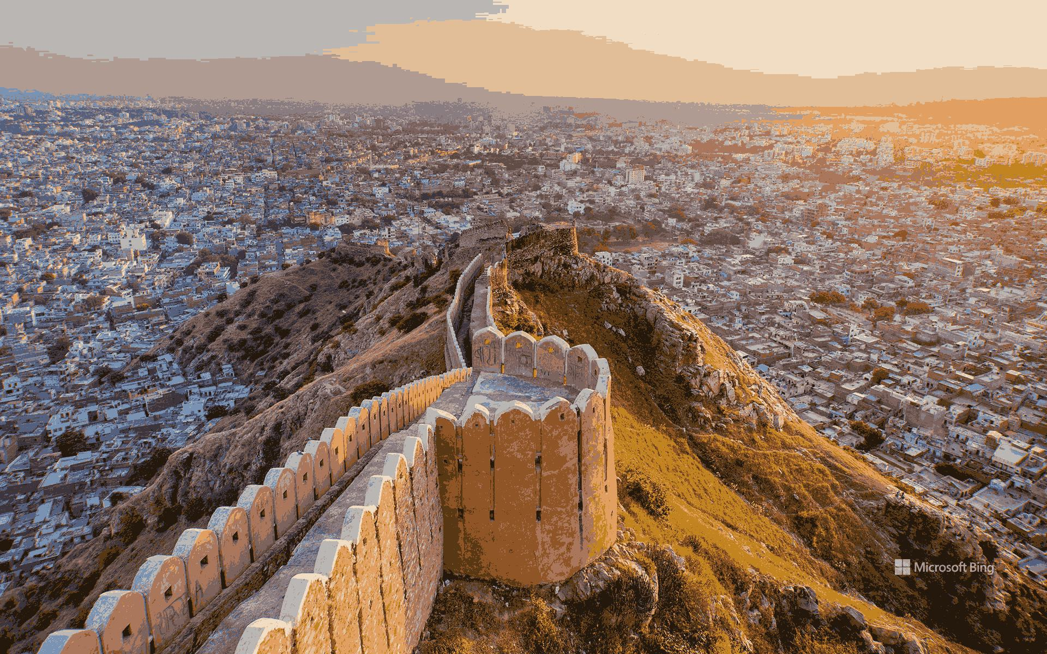
Image Compression
The original image
The compressed image

Slide 61
Wrapping up

Slide 62
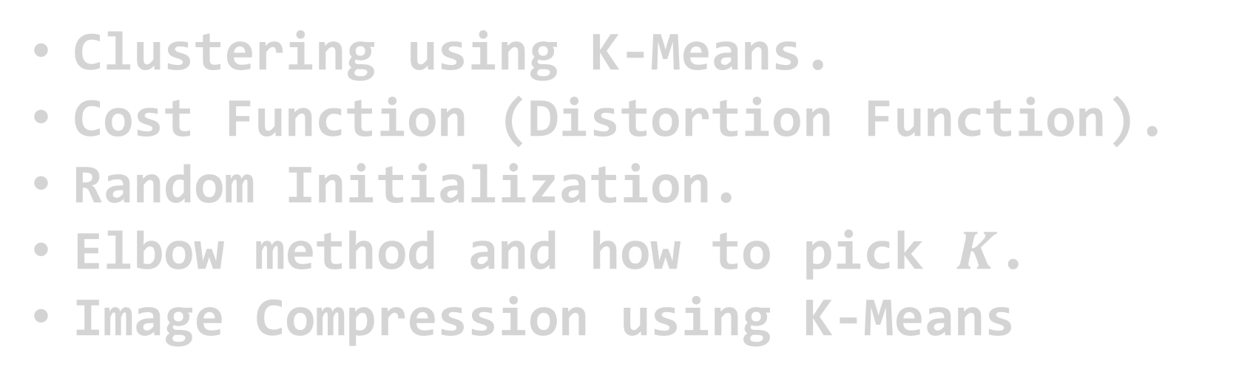
Wrapping up
Clustering using K-Means.
Cost Function (Distortion Function).
Random Initialization.
Elbow method and how to pick $K$.
Image Compression using K-Means
Thank you for sticking with me

Slide 63
What’s Next?

Slide 64
What’s Next?

Slide 65
What’s Next?
Datacamp:
Career tracks - DataCamp Learn
Books:
Rohan's -Data Science Collection - Google Drive
Andrew Ng courses: Courses - DeepLearning.AI
Machine Learning:
Machine Learning | Coursera
Deep Learning:
Deep Learning | Coursera
Google Data Science course:
Google Data Analytics Professional Certificate | Coursera
IBM Data Science course:
IBM Data Science Professional Certificate | Coursera

Slide 66
What’s Next?
YouTube channels:
(400) Andrej Karpathy - YouTube
StatQuest with Josh Starmer - YouTube
Khan Academy - YouTube
3Blue1Brown - YouTube
(400) Two Minute Papers - YouTube
sentdex - YouTube
Hesham Asem – YouTube

